Slide 1

E6156 – Cloud Computing:
Backend-as-a-Service
Lecture 7: DynamoDB (Continued), Lambda Functions, SNS, API Gateway
Donald F. Ferguson dff9@Columbia.edu
TRANSCENDING DISCIPLINES, TRANSFORMING LIVES

Slide 2

We will start in a couple of minutes.
2 | E6156 – Cloud Computing: Backend-as-a-Service

Slide 3
Content, Agenda
3 | E6156 – Cloud Computing: Backend-as-a-Service

Slide 4
Today’s Agenda
Questions and answers?
DynamoDB concepts, overview, sample code.
Lambda functions concepts, overview, sample code.
Simple Notification Service concepts, overview, web hooks, Slack, sample code.
Some REST API concepts:
Summary
ETags
Asynchronous execution.
Putting the pieces together:
Registration and security.
Registration notification.
4 | E6156 – Cloud Computing: Backend-as-a-Service (Lecture 7)

Slide 5
Questions, Answers
5 | E6156 – Cloud Computing: Backend-as-a-Service

Slide 6
DynamoDB Introduction and Examples (Continued and New Material)
6 | E6156 – Cloud Computing: Backend-as-a-Service

Slide 7
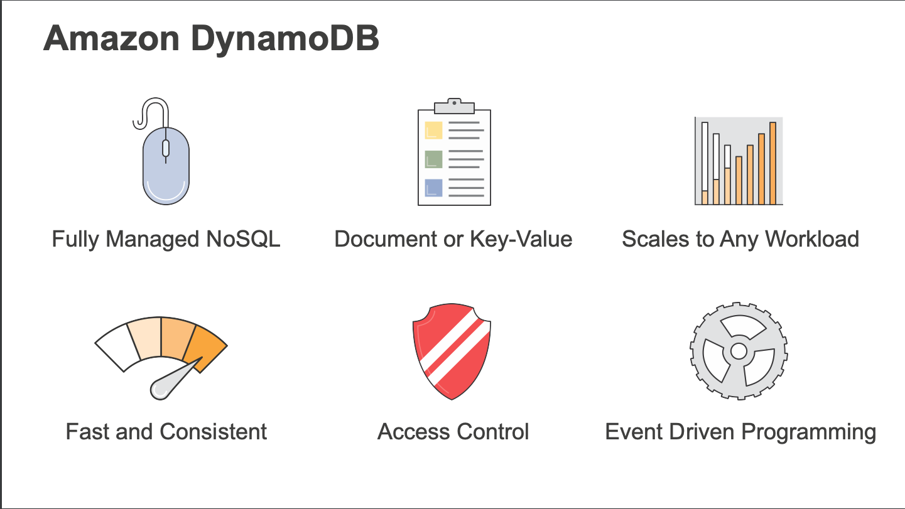
DynamoDB
7 | E6156 – Cloud Computing: Backend-as-a-Service (Lecture 6)

Slide 8
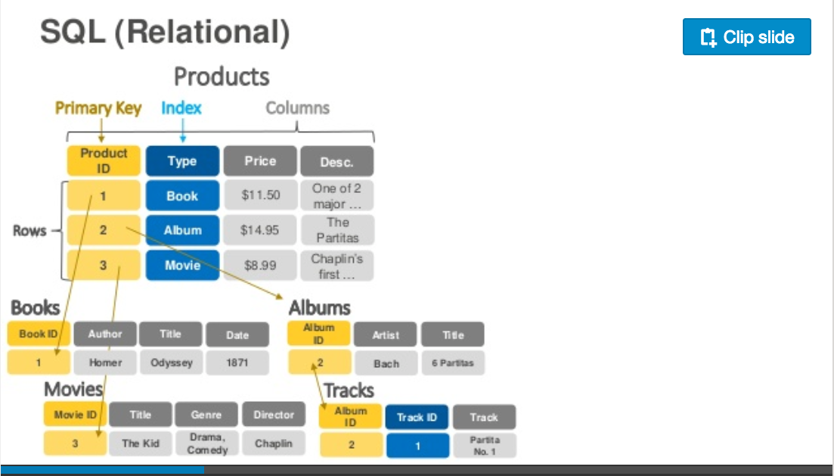
Relational Data Model
https://www.slideshare.net/AmazonWebServices/introduction-to-amazon-dynamodb-73191648
8 | E6156: Topics in SW Engineering – Cloud Computing/BaaS

Slide 9
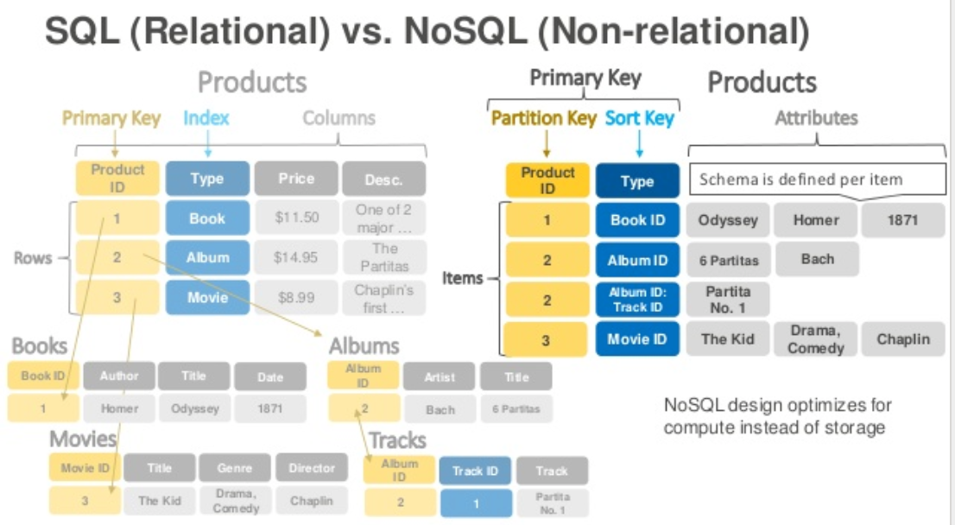
DynamoDB Model
9 | E6156: Topics in SW Engineering – Cloud Computing/BaaS

Slide 10
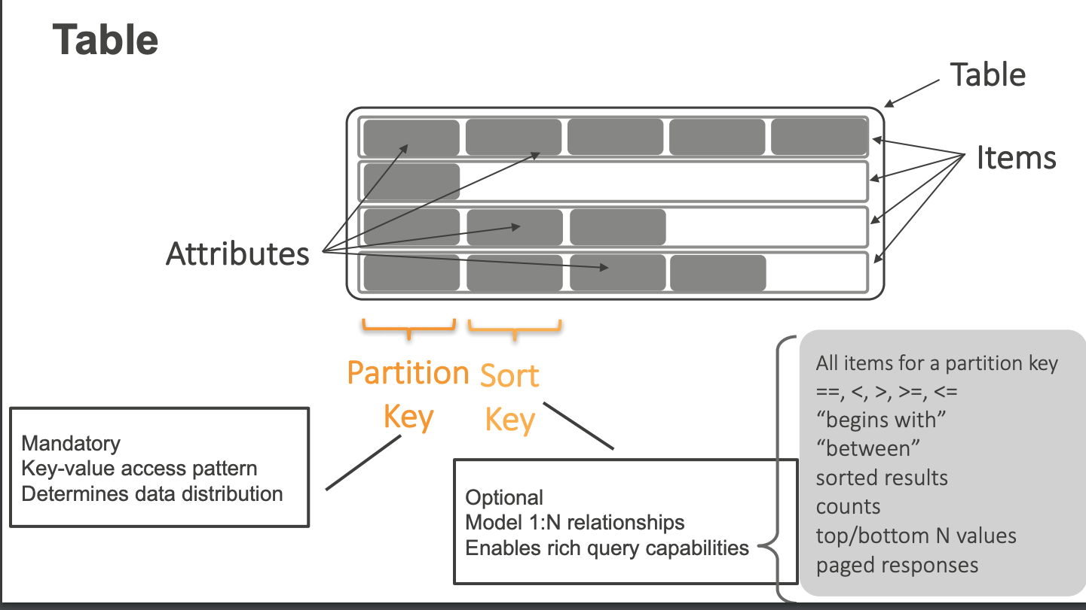
DynamoDB Model
10 | E6156: Topics in SW Engineering – Cloud Computing/BaaS

Slide 11
DynamoDB Model
11 | E6156: Topics in SW Engineering – Cloud Computing/BaaS

Slide 12
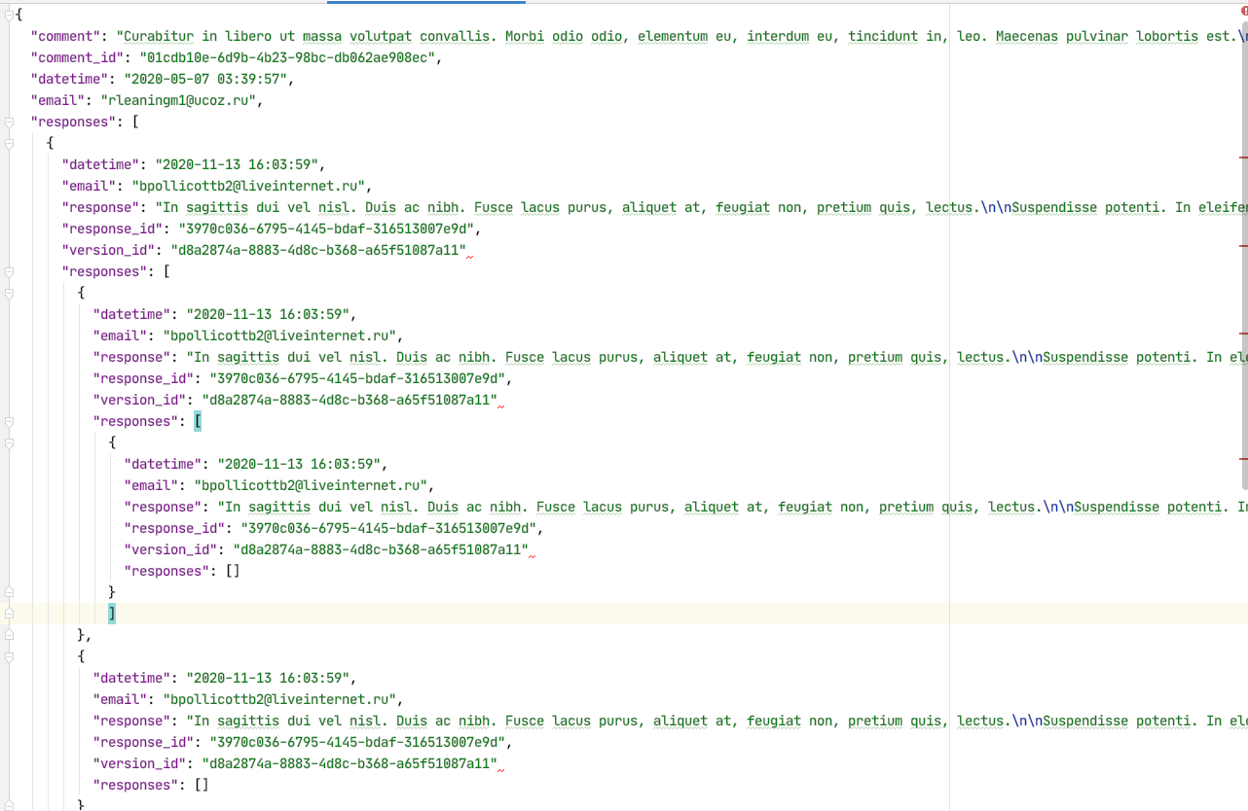
Document Databases – Semi-Structured Schema
The relation model has difficulties with some types of data:
Columns that are lists or maps
Nesting – things inside things
Discover you need a modified schema when you get a piece of data.
etc.
All of these are common for documented like data:
Threaded discussions.
Documents.
... ...
Document DBs emerged to handle these scenarios.
12 | E6156: Topics in SW Engineering – Cloud Computing/BaaS

Slide 13
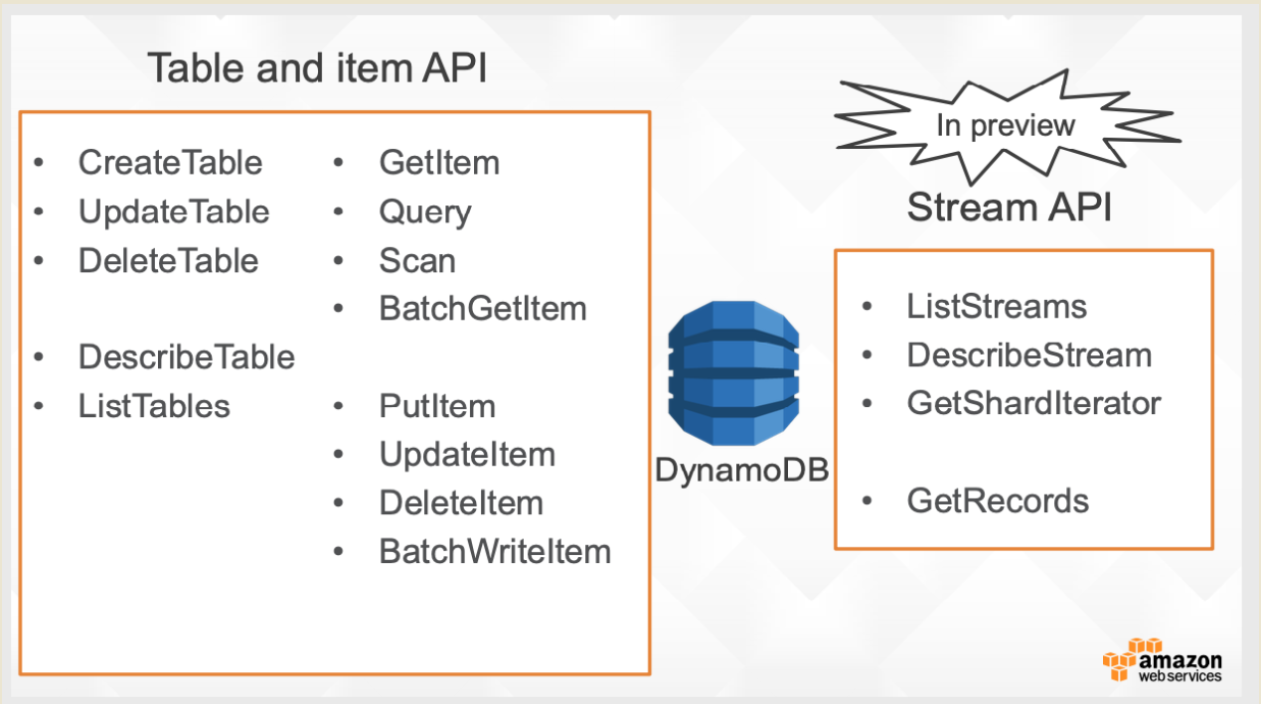
DynamoDB Model
13 | E6156: Topics in SW Engineering – Cloud Computing/BaaS

Slide 14
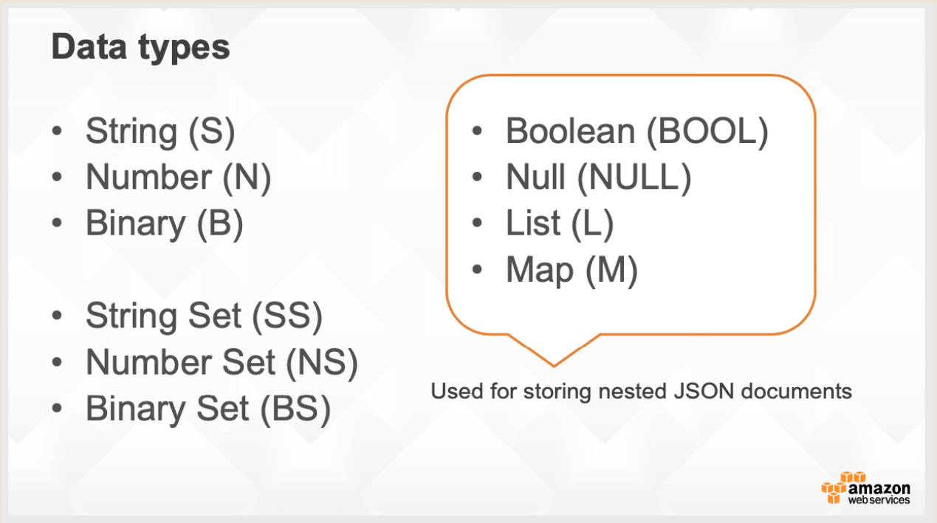
DynamoDB Model
14 | E6156: Topics in SW Engineering – Cloud Computing/BaaS

Slide 15
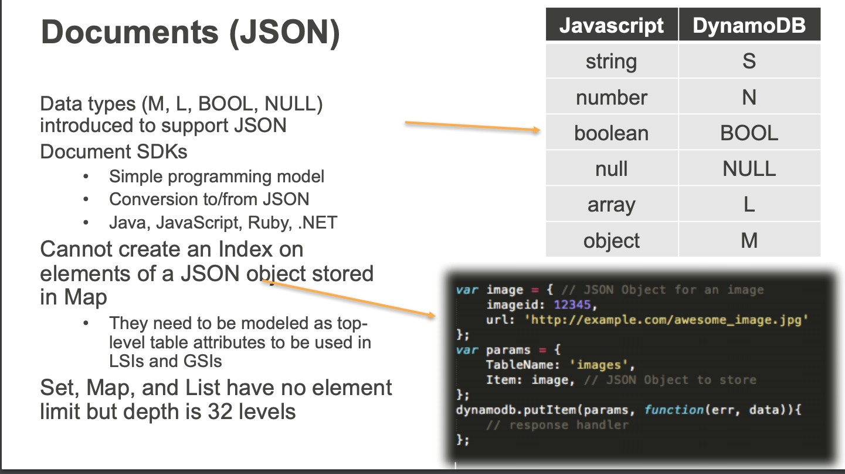
DynamoDB Model
15 | E6156: Topics in SW Engineering – Cloud Computing/BaaS

Slide 16
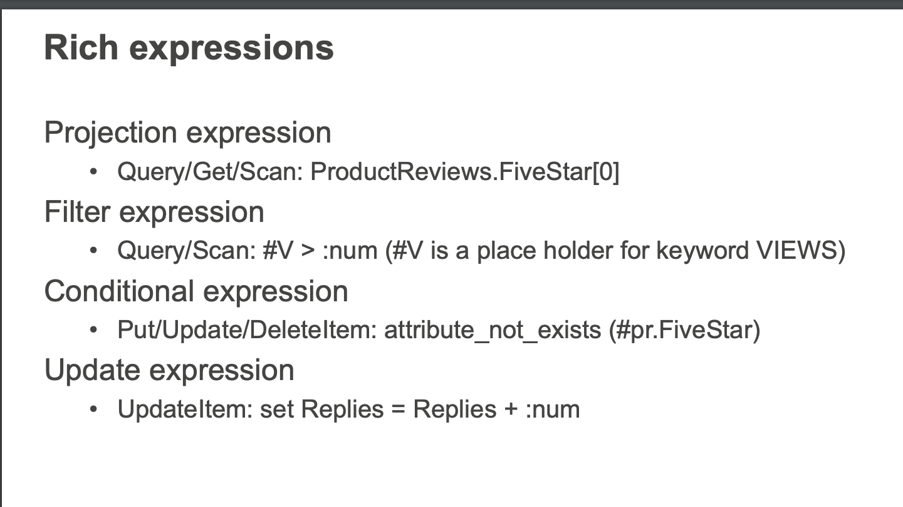
DynamoDB Model
These become interesting when we look at ETags and conditional updates in REST.
16 | E6156: Topics in SW Engineering – Cloud Computing/BaaS

Slide 17
Let’s Look at Some Code
17 | E6156: Topics in SW Engineering – Cloud Computing/BaaS

Slide 18
Shared Everything Shared Nothing
18 | E6156 – Cloud Computing: Backend-as-a-Service

Slide 19
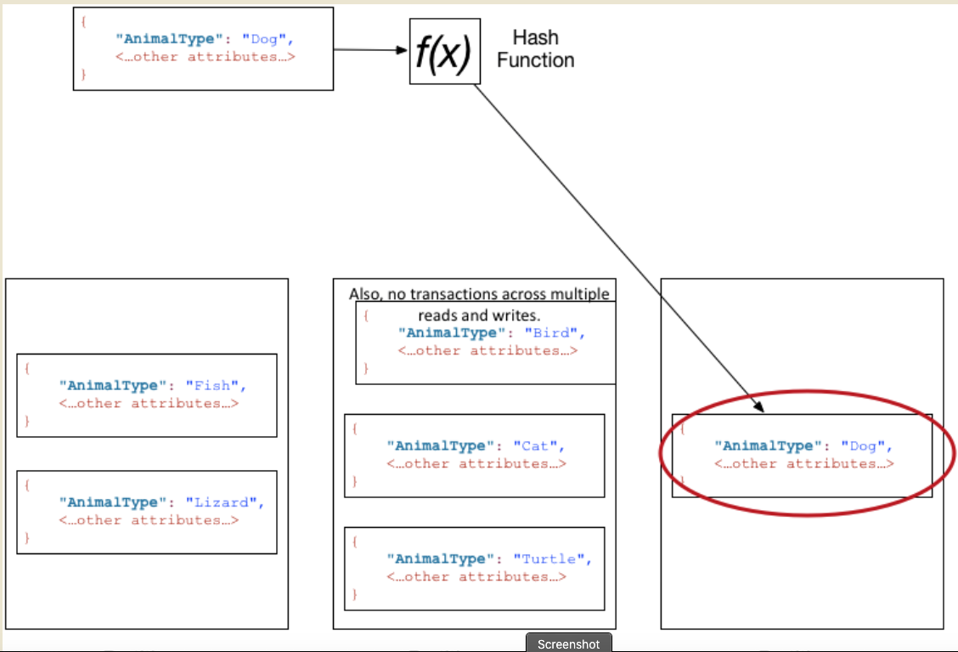
DynamoDB Model
19 | E6156: Topics in SW Engineering – Cloud Computing/BaaS

Slide 20
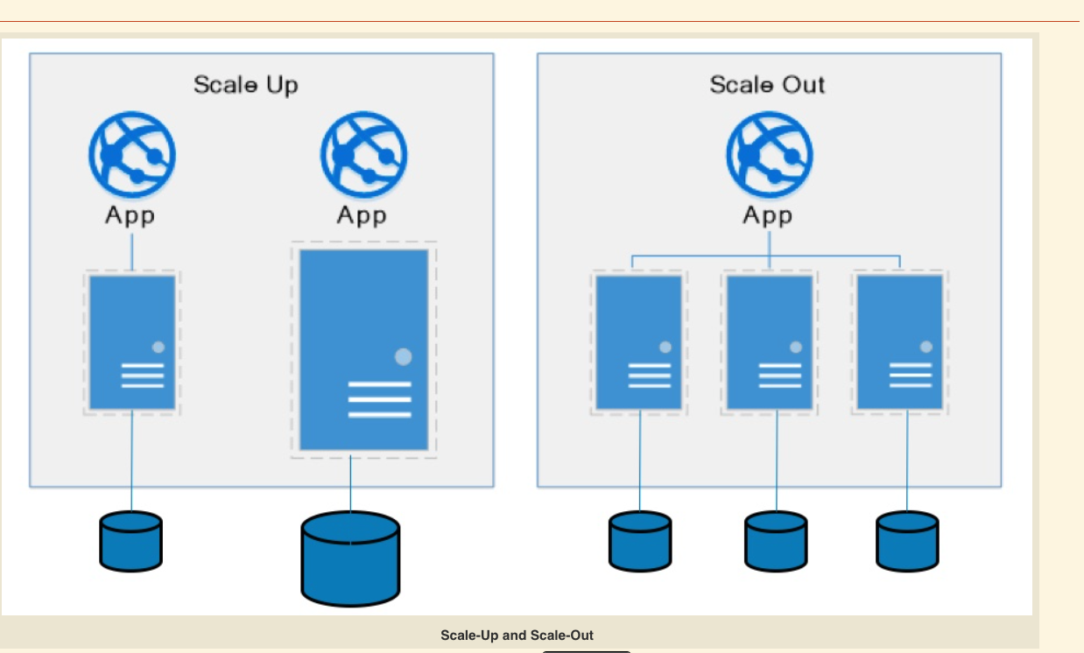
Some Database Concepts
20 | E6156: Topics in SW Engineering – Cloud Computing/BaaS

Slide 21
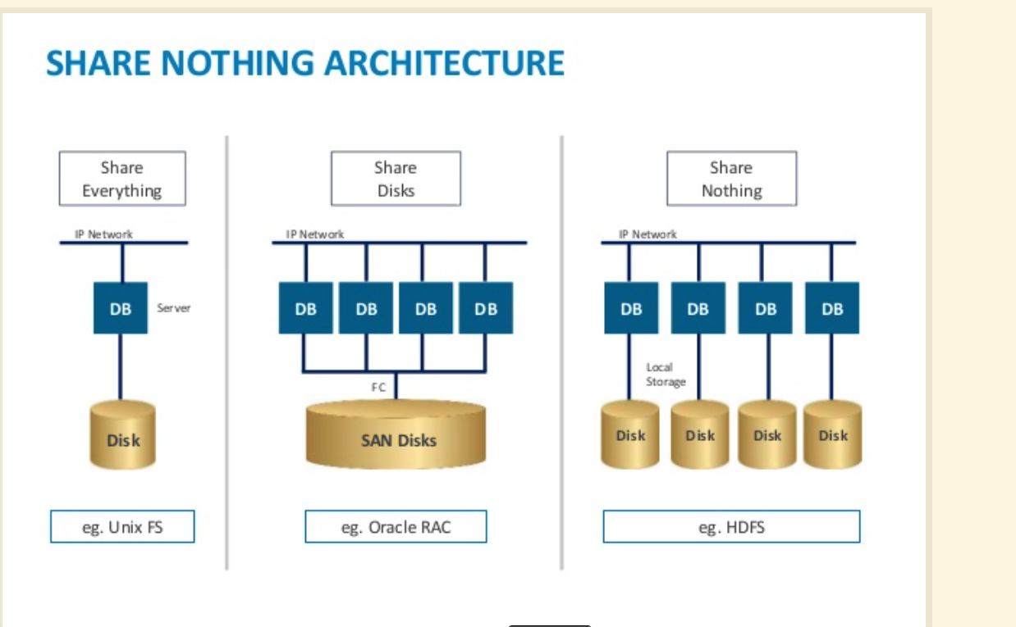
Some Database Concepts
21 | E6156: Topics in SW Engineering – Cloud Computing/BaaS

Slide 22
CAP Theorem
Consistency
Every read receives the most recent write or an error.
Availability
Every request receives a (non-error) response – without guarantee that it contains the most recent write.
Partition Tolerance
The system continues to operate despite an arbitrary number of messages being dropped (or delayed) by the network between nodes
22 | E6156: Topics in SW Engineering – Cloud Computing/BaaS

Slide 23
Availability and Consistency Requires Connected
There are two basic patterns
Active/Passive
All requests go to master during normal processing.
Updates are transactionally queued for processing at passive backup.
Failure of master
Routes subsequent requests to backup.
Backup must process and commit updates before accepting requests.
Active/Active
Both environments process requests.
Some form of distributed transaction commit required to synchronize updates on both copies.
Multi-system communication to guarantee consistency is the foundation for tradeoffs in CAP.
The system can be CAP if and only iff
There are never any partitions or system failures
Which is unrealistic in cloud/Internet systems.
23 | E6156: Topics in SW Engineering – Cloud Computing/BaaS

Slide 24
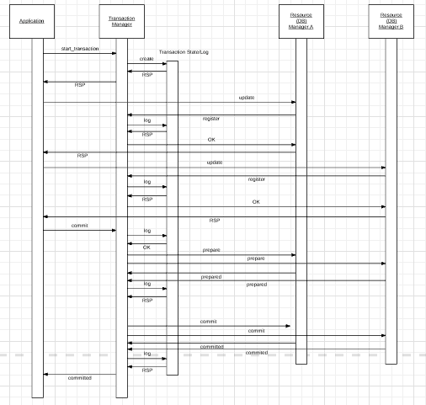
Availability and Consistency Requires Connected
“In transaction processing, databases, and computer networking, the two-phase commit protocol (2PC) is a type of atomic commitment protocol (ACP). It is a distributed algorithm that coordinates all the processes that participate in a distributed atomic transaction on whether to commit or abort (roll back) the transaction (it is a specialized type of consensus protocol). The protocol achieves its goal even in many cases of temporary system failure (involving either process, network node, communication, etc. failures), and is thus widely used” (www.wikipedia.org)
Note: This sequence diagram omits some steps.
Uses:
ACID, especially consistency, for data in different databases/services.
Modified approach is required to strictly achieve consistency and availability for replicated data,
24 | E6156: Topics in SW Engineering – Cloud Computing/BaaS

Slide 25
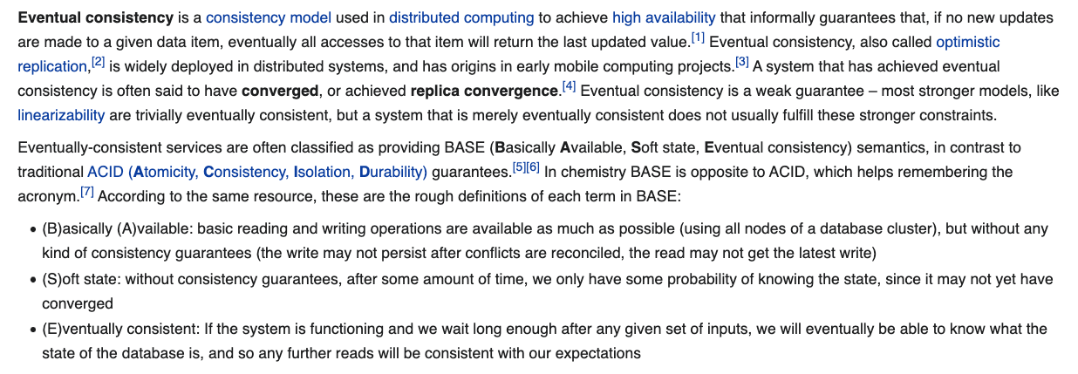
Eventual Consistency
The preceding two slides were simplistic overviews of some of the concepts.
If the DB tolerates network partitions, the DB must either: return error or potentially out of date values.
Achieving availability → you must have multiple copies of the data.
Consistency requires some form of distributed synchronization for updates → cannot tolerate partitions.
Availability and partition tolerance → cannot synchronize updates.
For a lot of applications,
You do not need ACID properties
You cannot achieve the massive, required scale and achieve ACID properties.
All of this is an overly simplistic explanation of some pretty complex concepts and alternatives.
25 | E6156: Topics in SW Engineering – Cloud Computing/BaaS

Slide 26
Function-as-a-Service Lambda Functions
26 | E6156 – Cloud Computing: Backend-as-a-Service

Slide 27
Terminology and Definitions Stolen from theWeb
Serverless computing is a cloud computing execution model in which the cloud provider runs the server, and dynamically manages the allocation of machine resources. Pricing is based on the actual amount of resources consumed by an application, rather than on pre-purchased units of capacity.^{[1]} It can be a form of utility computing. Serverless computing can simplify the process of deploying code into production. Scaling, capacity planning and maintenance operations may be hidden from the developer or operator. Serverless code can be used in conjunction with code deployed in traditional styles, such as microservices. Alternatively, applications can be written to be purely serverless and use no provisioned servers at all.^{[2]} This should not be confused with computing or networking models that do not require an actual server to function, such as peer-to-peer (P2P).”
Function as a service (FaaS) is a category of cloud computing services that provides a platform allowing customers to develop, run, and manage application functionalities without the complexity of building and maintaining the infrastructure typically associated with developing and launching an app.^{[1]} Building an application following this model is one way of achieving a "serverless" architecture, and is typically used when building microservices applications.”
That was baffling:
IaaS, CaaS – You control the SW stack and the cloud provides (virtual) HW.
PaaS – The cloud hides the lower layer SW and provides an application container (e.g. Flask) with “Your code goes here.” You are aware of container.
FaaS – The cloud provides the container, and you implement functions (corresponding to routes in REST).
27 | E6156 – Cloud Computing: Backend-as-a-Service (Lecture 6)

Slide 28
Serverless/Function-as-a-Service
https://medium.com/@tanmayct/serverless-architecture-function-as-a-service-19e127b8c990
28 | E6156 – Cloud Computing: Backend-as-a-Service (Lecture 6)

Slide 29
Two Perspectives on this Stuff
29 | E6156 – Cloud Computing: Backend-as-a-Service (Lecture 6)

Slide 30









What is Serverless good for?
Serverless is good for
short-running
stateless
event-driven
Serverless is not good for
long-running
stateful
number crunching
Microservices
Databases
Mobile Backends
Deep Learning Training
Bots, ML Inferencing
Heavy-Duty Stream Analytics
IoT
f(x)
Numerical Simulation
Modest Stream Processing
Video Streaming
Service integration
https://www.serverlesscomputing.org/wosc3/presentations/intro.pptx

Slide 31
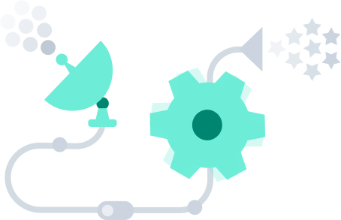
What triggers code execution?
Runs code in response to events
Event-programming model
Notes:
What is Serverless

Slide 32



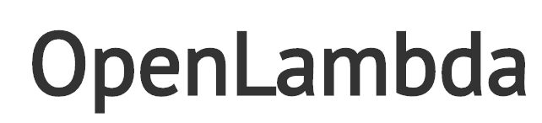



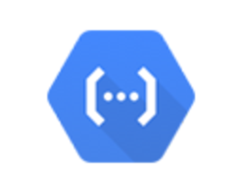



Current Platforms for Serverless
AWS Lambda
Azure Functions
Kubernetes
IBM Cloud Functions
Red-Hat
Google Functions
Notes:
Auth0, Twitter, ..
And many more upcoming / open source

Slide 33
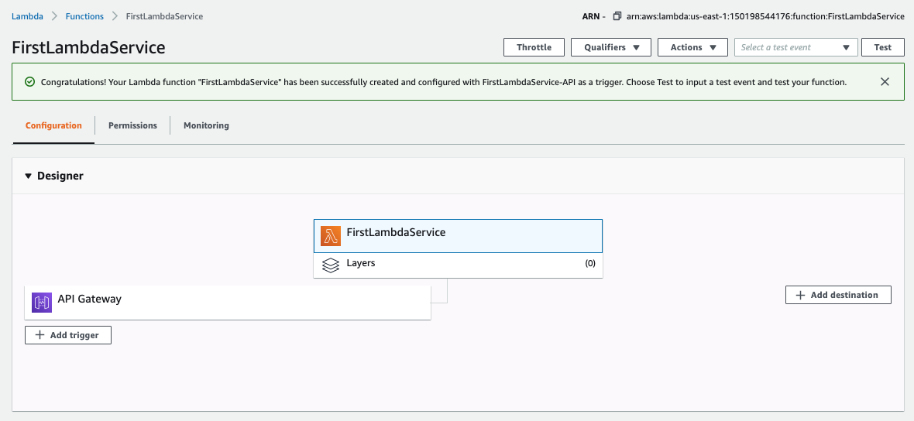
Lambda Function
33 | E6156: Topics in SW Engineering – Cloud Computing/BaaS

Slide 34
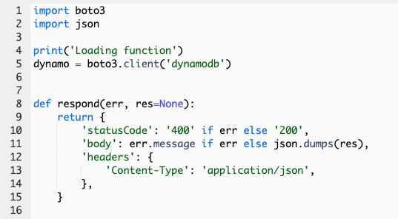
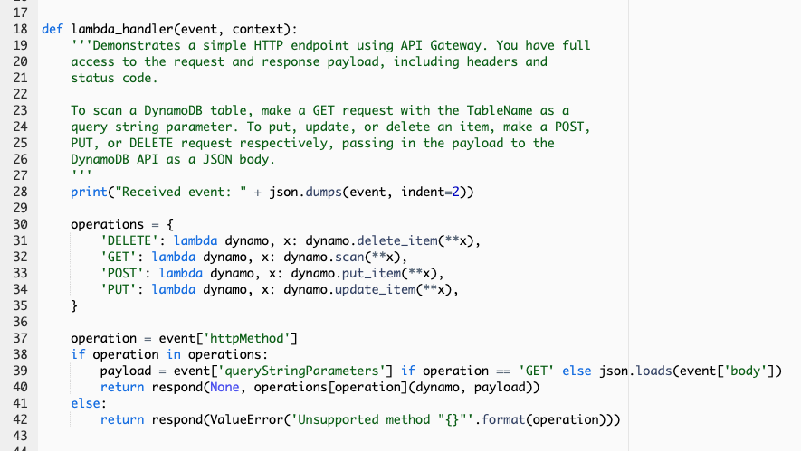
Lambda Function
34 | E6156: Topics in SW Engineering – Cloud Computing/BaaS

Slide 35
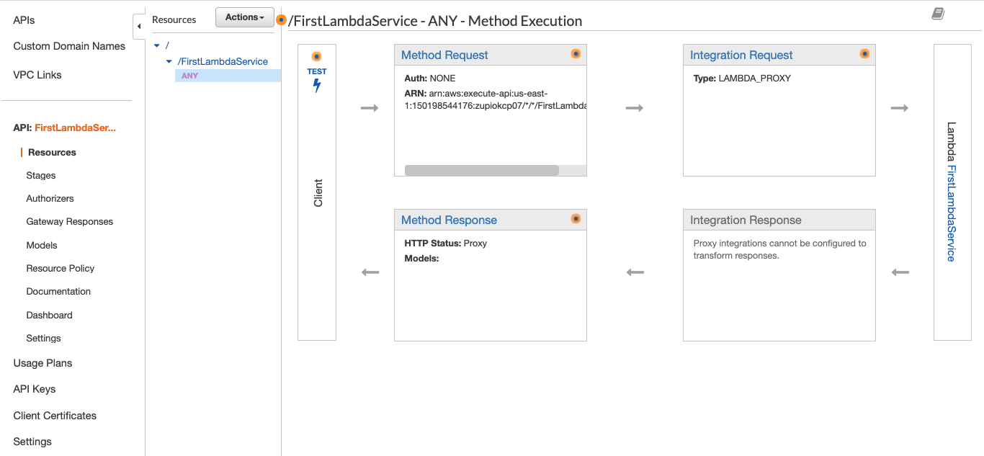
API Gateway Event
35 | E6156: Topics in SW Engineering – Cloud Computing/BaaS

Slide 36
Demo/Samples
Let’s take it for a spin.
36 | E6156 – Cloud Computing: Backend-as-a-Service (Lecture 6)

Slide 37
Demo/Samples
Let’s take it for a spin.
37 | E6156 – Cloud Computing: Backend-as-a-Service (Lecture 6)

Slide 38
Pub/Sub
38 | E6156 – Cloud Computing: Backend-as-a-Service

Slide 39
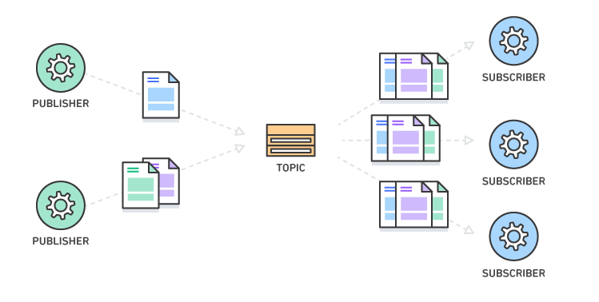
Pub/Sub – Event Driven Processing
“In software architecture, publish–subscribe is a messaging pattern where senders of messages, called publishers, do not program the messages to be sent directly to specific receivers, called subscribers, but instead categorize published messages into classes without knowledge of which subscribers, if any, there may be. Similarly, subscribers express interest in one or more classes and only receive messages that are of interest, without knowledge of which publishers, if any, there are.
Publish–subscribe is a sibling of the message queue paradigm, and is typically one part of a larger message-oriented middleware system. Most messaging systems support both the pub/sub and message queue models in their API, e.g. Java Message Service (JMS).
This pattern provides greater network scalability and a more dynamic network topology, with a resulting decreased flexibility to modify the publisher and the structure of the published data.”
It also support loose coupling for application evolution and agility.
I can add and evolve services without modifying the services.
https://en.wikipedia.org/wiki/Publish%E2%80%93subscribe_pattern
39 | E6156: Topics in SW Engineering – Cloud Computing/BaaS

Slide 40
Pub/Sub – Simple Notification Service
40 | E6156: Topics in SW Engineering – Cloud Computing/BaaS

Slide 41
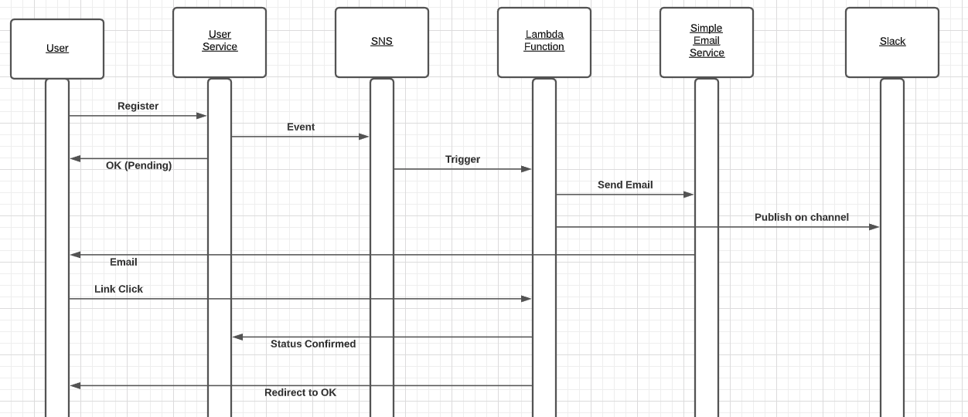
Scenario – Email ID Verification
Users provide email IDs when registering with the overall application.
Account is pending until email ownership verified.
User receives and email with activation link. Clicking on link changes account state to active.
Some, e.g. interested business person, sees notification on a Slack channel.
41 | E6156: Topics in SW Engineering – Cloud Computing/BaaS

Slide 42
Demo/Samples
Let’s take it for a spin.
42 | E6156 – Cloud Computing: Backend-as-a-Service (Lecture 6)

